Slide 1


Slide 2
Experience Sea Kayaking
SAFELY
EFFICIENTLY
WITH MOUNTAINEERS GROUPS
BEGIN BUILDING SELF SUFFICIENCY
HAVE FUN – PLAY!

Slide 3
Course Agenda
6-9pm tonight: Classroom session
1:30-4:30pm Saturday: Wet Exit / Rescues
  Shelton High School Pool
5:30-8:30pm Wednesday: Online instruction session
9:00am-4pm Saturday: Open Water
  Kenneydell Park, Black Lake
9:00am-4pm Sunday: Wet Paddle
  Swantown Boat Ramp
Experience Paddle

Slide 4
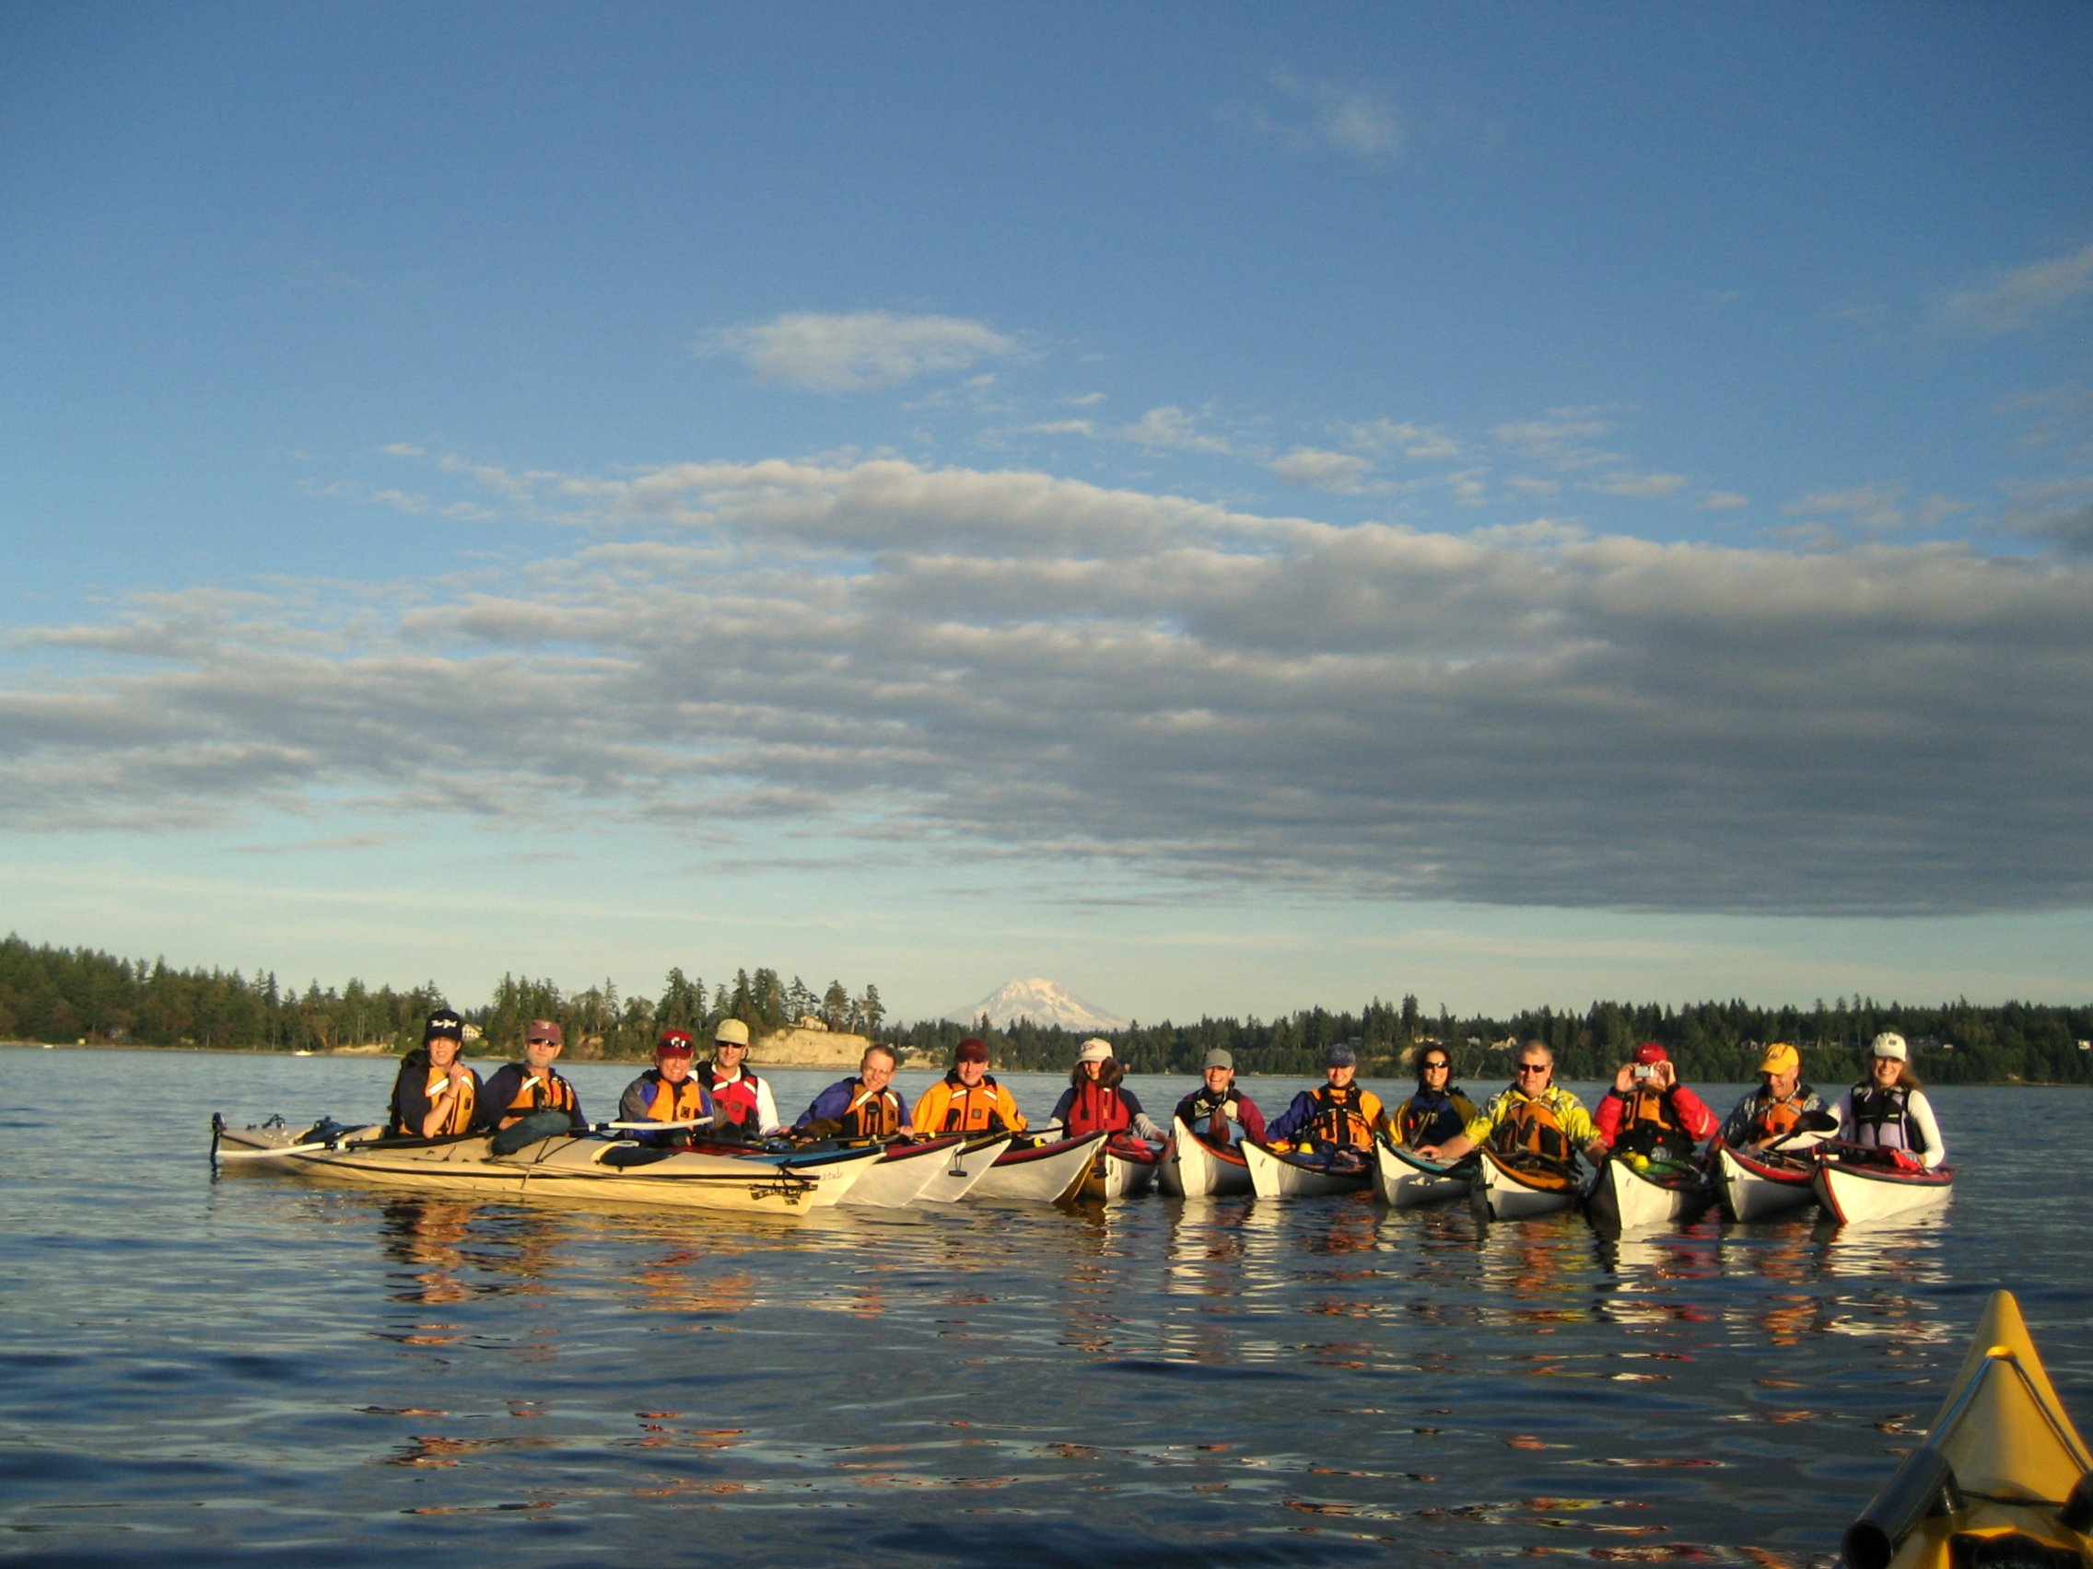
Equipment for Sea Kayaking

Slide 5
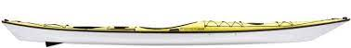
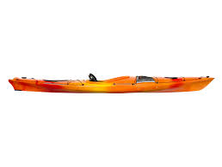
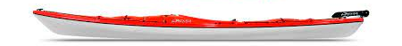
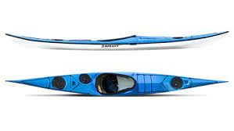
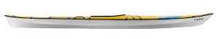
SEA KAYAKS
Defining Characteristics
► Safe travel in open water
► 14 – 18’ length
► Sit inside
► Cockpit closed with spray skirt
► Sealed space in both ends for
floatation
► Hull shape for efficient cruising
and dependable performance
in wind and rough water
► Able to be quickly recovered
from deep water capsize

Slide 6
SEA KAYAKS
Materials
► Composite – fiberglass, Kevlar,
carbon fiber with polyester or
epoxy resin
► Plastic – polyethylene or rigid
thermoformed
► Fabric over rigid frame
► Wood with fiberglass/epoxy
finish

Slide 7
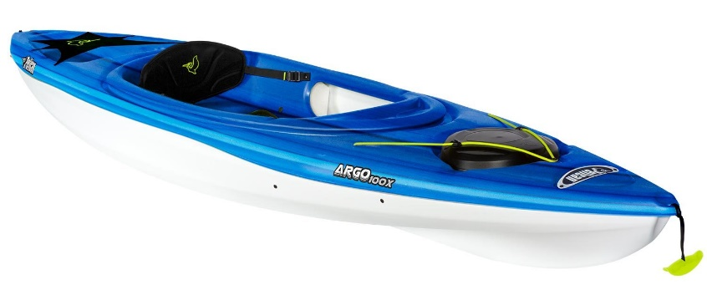
NOT SEA KAYAKS
X Recreational kayaks
X Sit on top kayaks
X Whitewater kayaks
X Surf skis

Slide 8
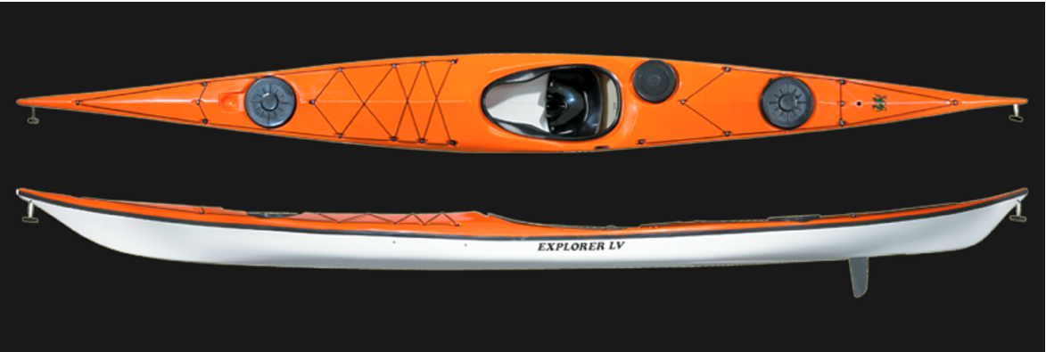
PARTS OF A KAYAK
Plus:
Size: Length
Waterline length
Beam (width)
Shape: Chine
  Hard
  Soft
Rocker
More Parts:
Keel
Rudder or Skeg
Thighbrace
Backrest – back band

Slide 9
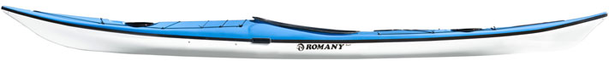
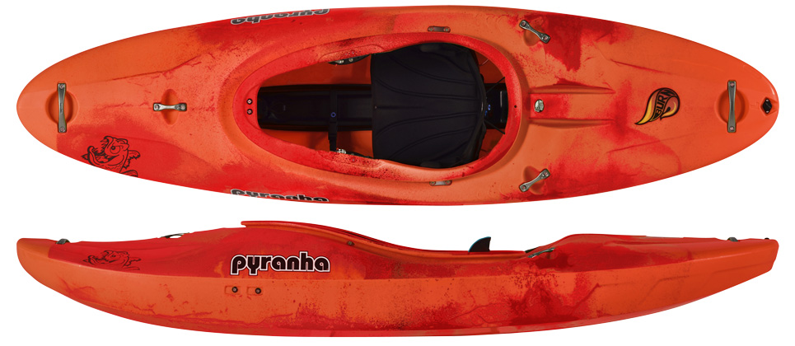
Shape makes a difference
ROCKER
Log vs. banana

Slide 10
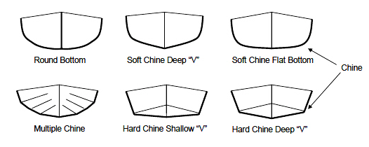
Shape makes a difference
CHINES
Barrel vs. box

Slide 11

Shape makes a difference
Edging

Slide 12
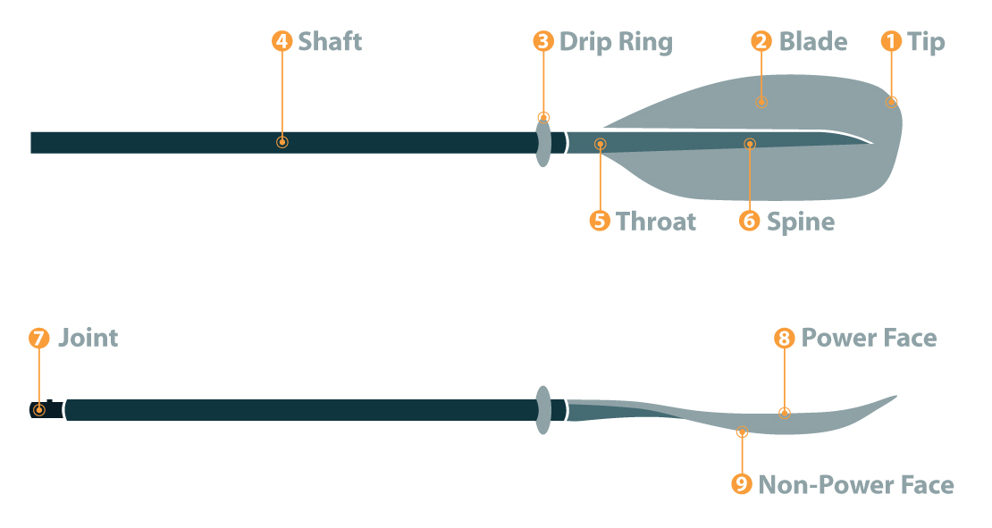
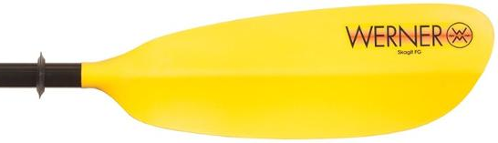
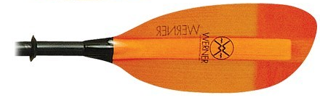
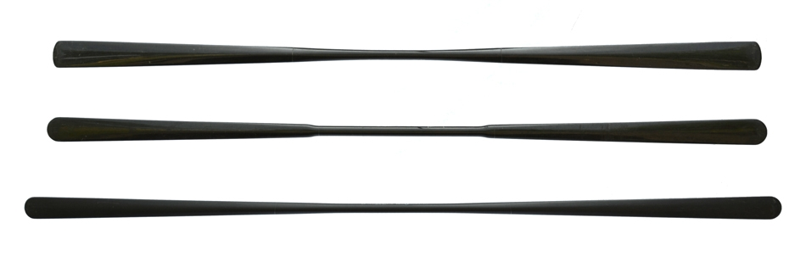
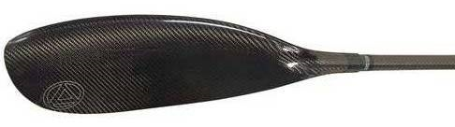
SEA KAYAK PADDLES
Styles - asymmetric
Parts
Touring low angle
Touring high angle
Performance high angle
Greenland
Wing

Slide 13
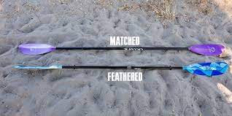
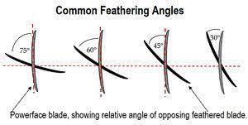
Paddles – Feathered vs. Unfeathered (Matched)

Slide 14
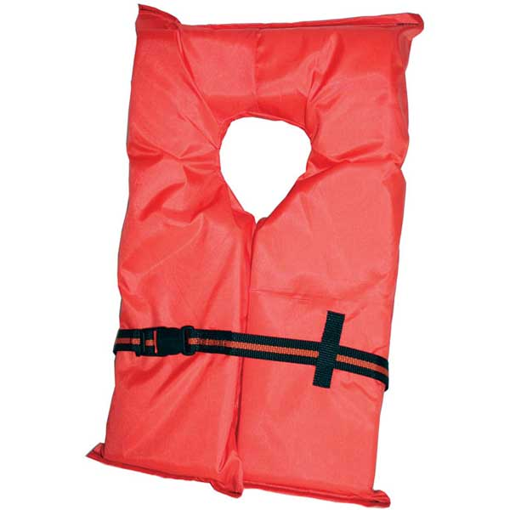
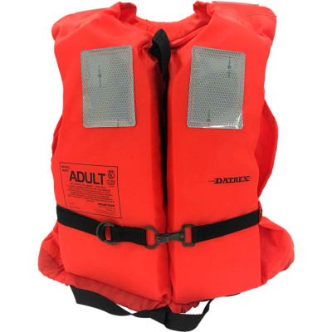
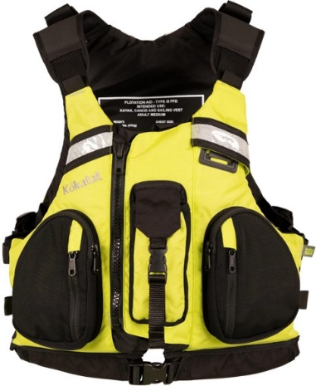

PFD’s
(personal floatation devices)
Type I
Offshore Life Jacket
Type II
Near Shore Life Jacket
Type III is most applicable to sea kayaking
Fit low and tight – shouldn’t ride up around ears
Unrestricted arm movement
Available in sizes and women’s models
Will:
  Help keep you on the surface
  Allow you to set up for self or assisted rescue
Won’t:
  Keep your face out of the water if you are unconscious
  Keep your face from periodically going under in rough conditions
Type III
Floatation Aid
Type V
Inflated Hybrid
Type IV
Throwable Device

Slide 15
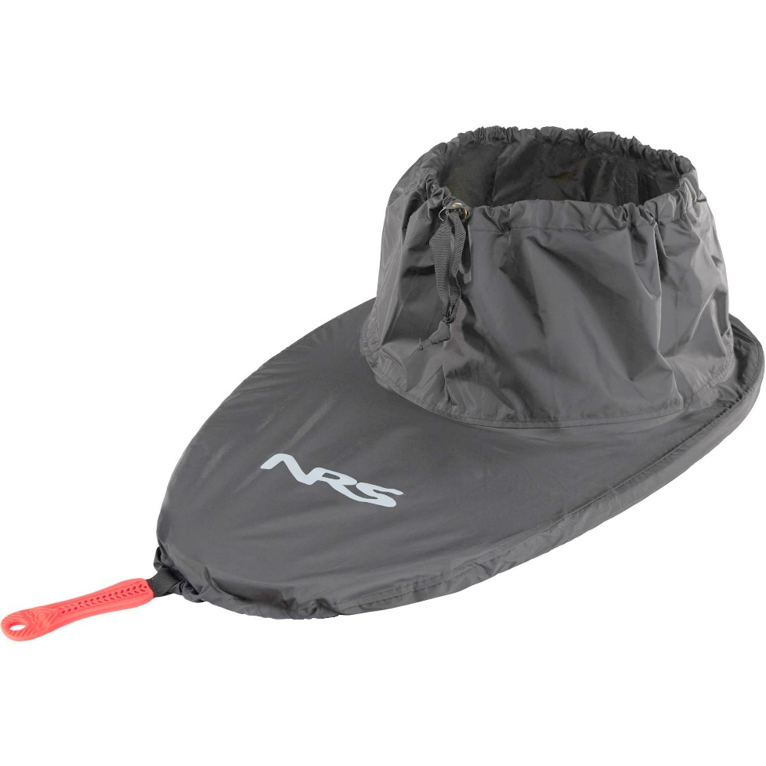
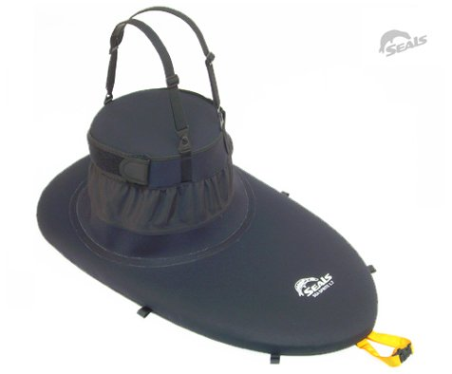
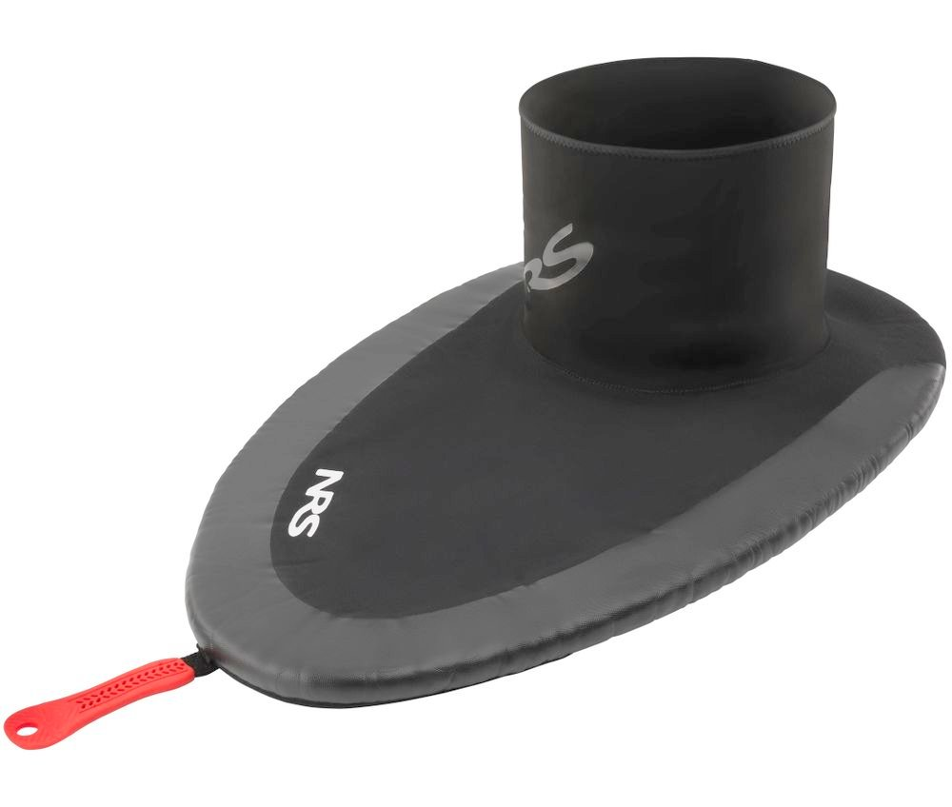
Tunnel size
SPRAY SKIRTS
Keeping you dry and water out of the kayak in rough conditions
Spray skirts have two sizes
Cockpit rim size
All nylon
Neoprene deck
Nylon tunnel
All neoprene

Slide 16
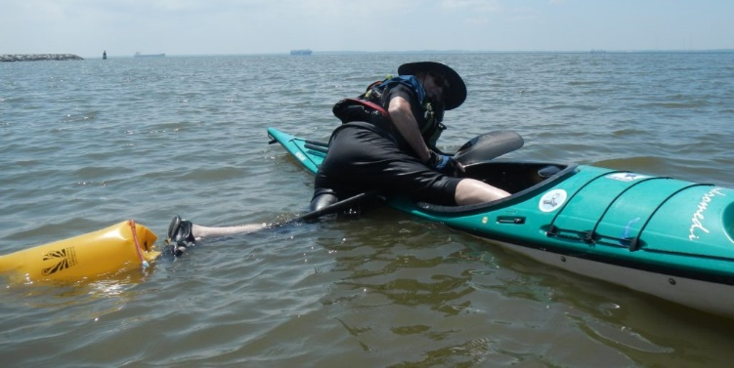
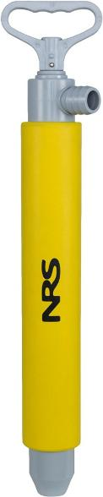
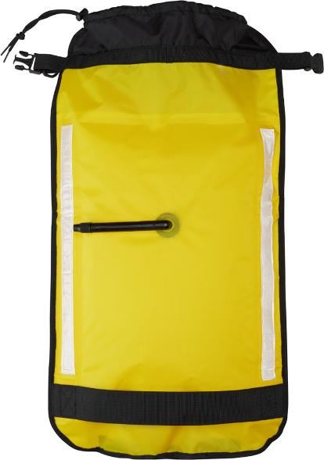
PUMPS AND PADDLE FLOATS
Rescue Tools
Should have foam floatation
Two air chambers are better

Slide 17
Required and Recommended Equipment For Kayakers
Sea Kayak Related Equipment
Sea kayak with flotation in both ends.
Paddle
Bilge pump
Paddle float
Spray skirt
USCG approved PFD
Appropriate attire for the conditions
Whistle
Flares (open water beyond Puget Sound and
Hood Canal)
Additional Recommended Kayak Equipment (may be required by leader)
Paddle tether
Sponge
Rescue sling
Waterproof jacket
50 ft floating tow rope
Wet suit or dry suit
Pogies or gloves
VHF Radio
Toilet paper, trowel and plastic bag
Spare paddle
Chemical light stick
Deck light
Waterproof wristwatch
Sea Kayaking Ten Essentials
1. Navigation (Chart and compass)
2. Spare clothing in a dry bag
3. Water
4. Food
5. First aid supplies
6. Lighter or waterproof matches
7. Sun protection (sun screen, hat, sunglasses w/retainer).
8. Illumination (flashlight or headlamp)
9. Emergency shelter appropriate for the trip
10.Repair kit appropriate for trip and gear

Slide 18
Safety
Lifting and carrying boats
Stretching
Weather
Tides & Currents
Paddling in COLD water

Slide 19
Paddling in Cold Water
Cold Water: Below 60 Degrees
Water cools 20 times faster than air
Hypothermia: Having an abnormally low body [core] temperature, typically one that is dangerously low
4 Stages of Cold Water Immersion:
  Cold shock response
  Cold incapacitation
  Hypothermia
  Circum-rescue collapse (related to abrupt drop in blood pressure)
1 – 10 – 1 Principle:
  Breathing control
  Meaningful movement
  Unconsciousness

Slide 20
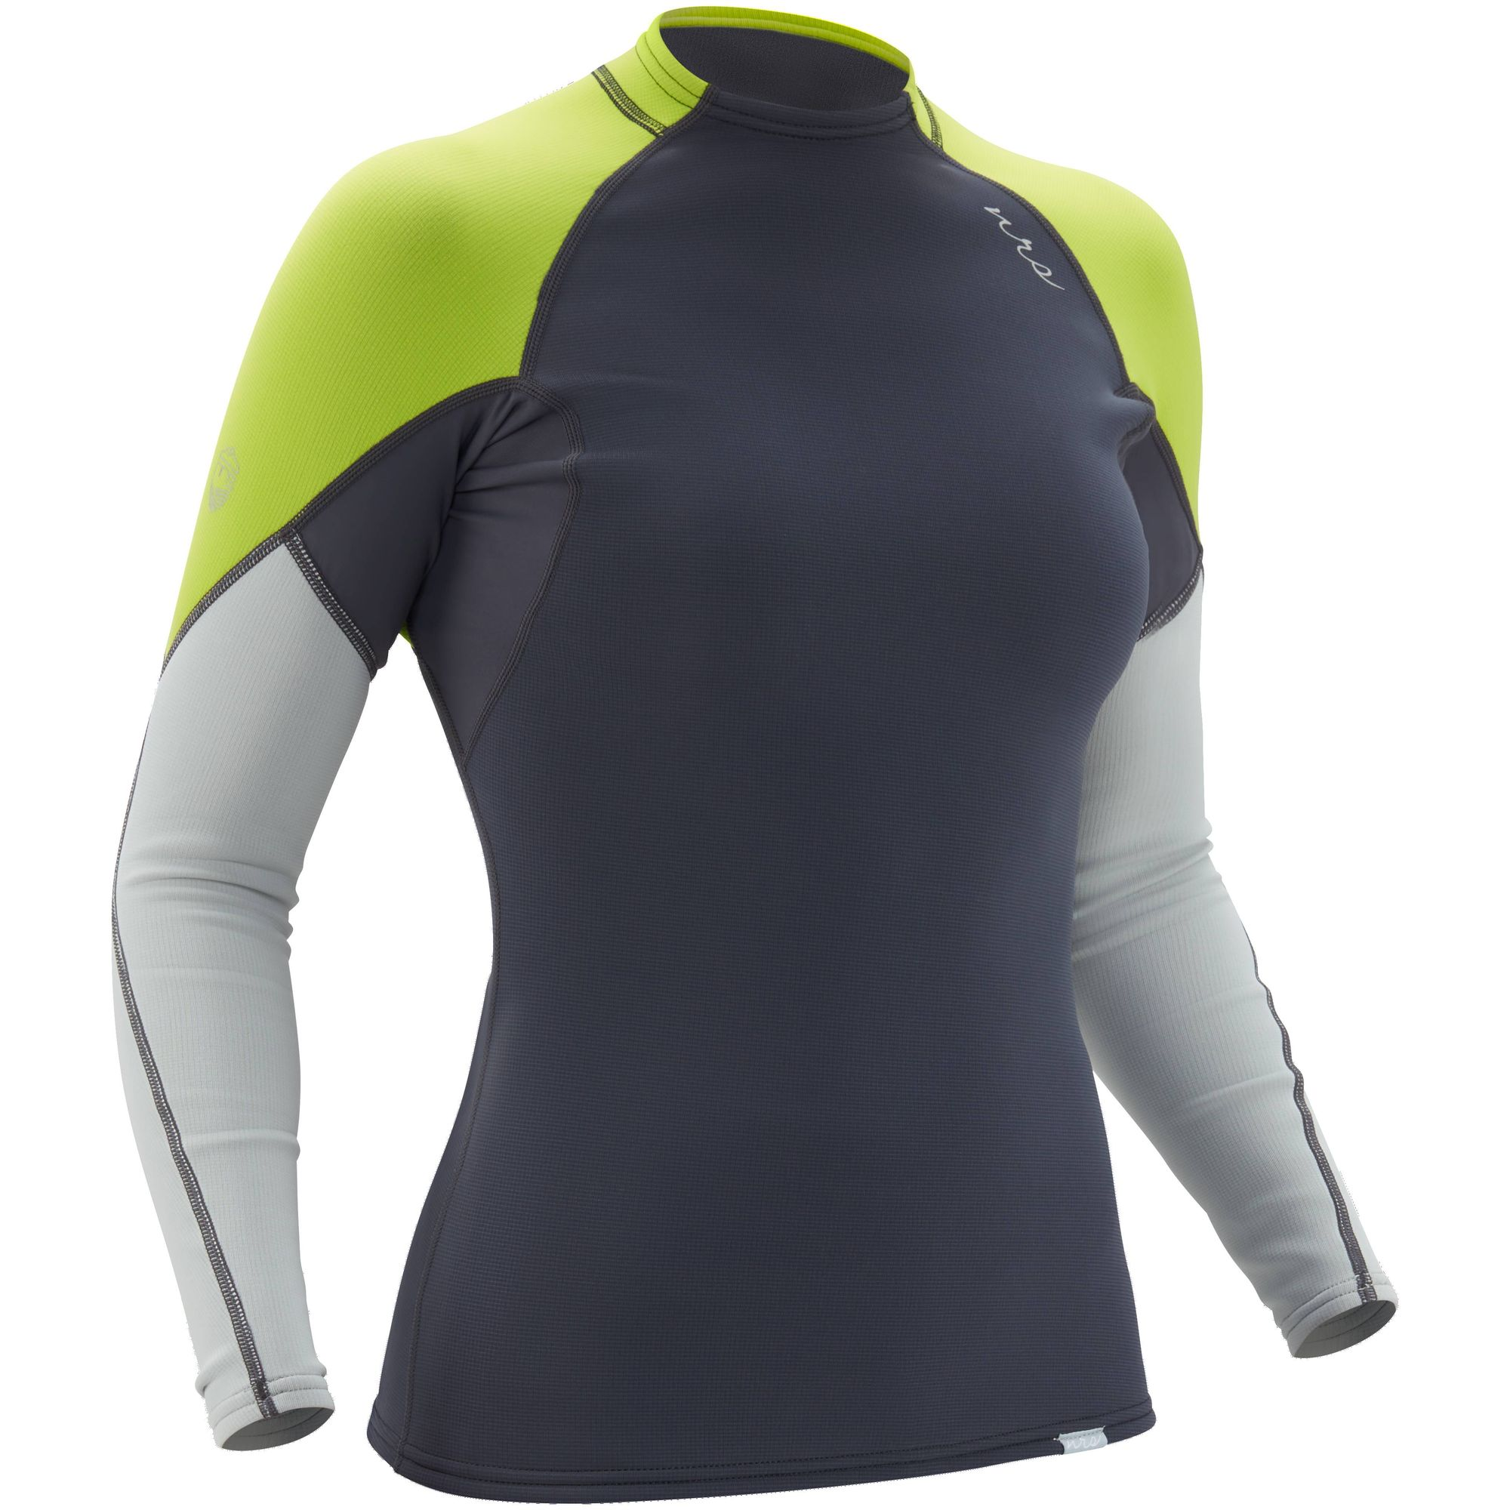
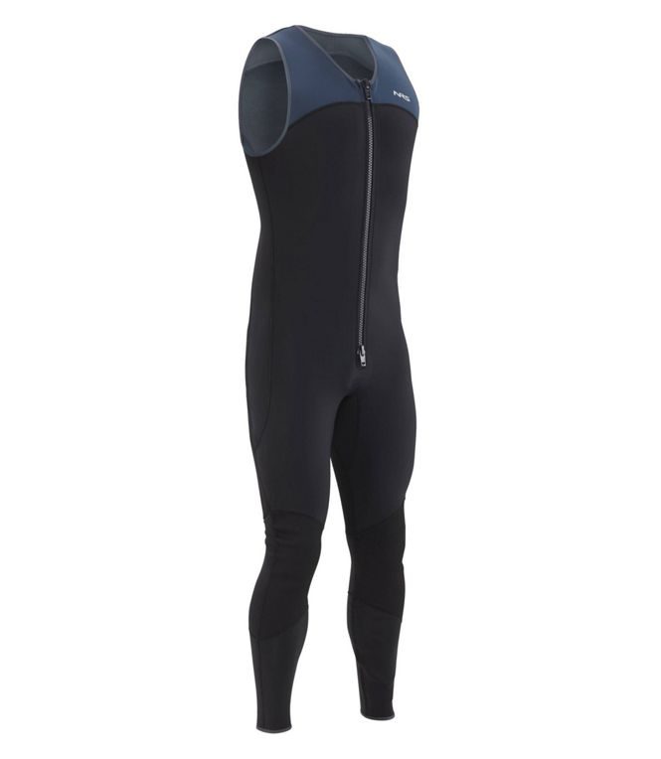
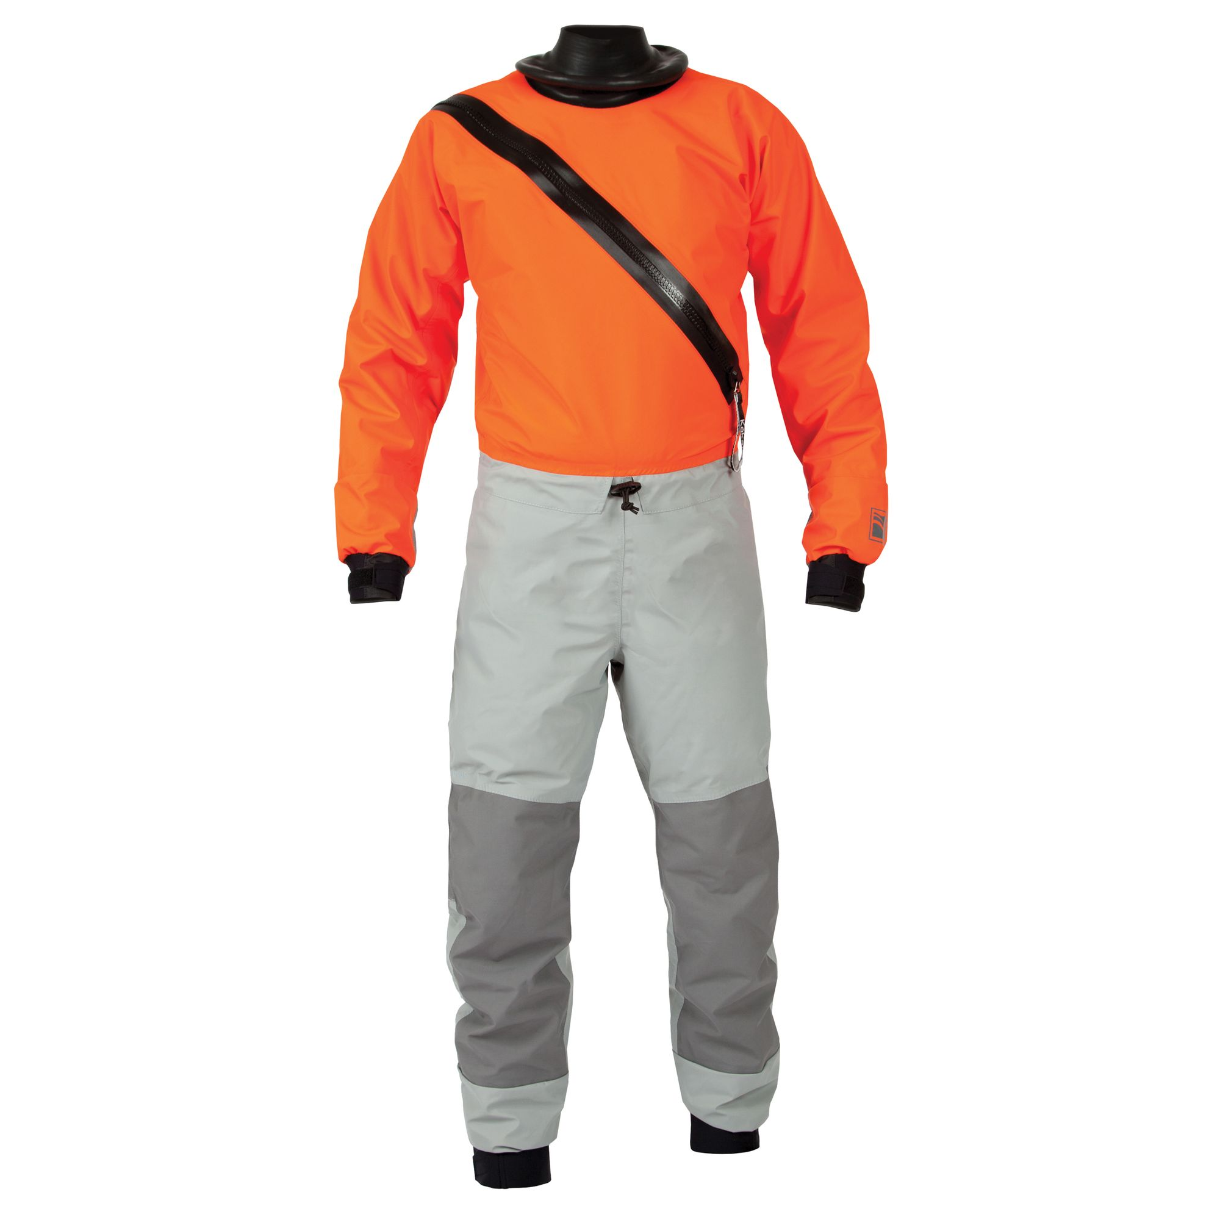
Paddling in Cold Water
Water Temperature (F) | Unconsciousness | Survival
32-40 | 15-30 minutes | 30-90 minutes
40-50 | 30-60 minutes | 1-3 hours
50-60 | 1-2 hours | 1-6 hours
Flotation: Drowning or hypothermia?
Immersion Protection: Dress for the water temperature

Slide 21
Paddling in Cold Water
Be prepared, avoid accidents
Keep as much of your body out of the water as possible
H.E.L.P: Heat Escape Lessening Posture
Huddle: 2 or more people
Should I swim to shore:
  Convection
  Vasoconstriction of extremities
First Aid:
  Airway, breathing, CPR if necessary (not dead until warm and dead)
  Prevent further heat loss: shelter, rapid warming, dry clothing, blankets, warm water bottle
  Be gentle but be quick
  Evacuate to hospital

Slide 22
Intro to Charts
Latitude/Longitude
Scale
Compass Rose (magnetic variation)
Depths – Fathoms below MSL
Heights – Feet above MSL
Markers
Symbols

Slide 23
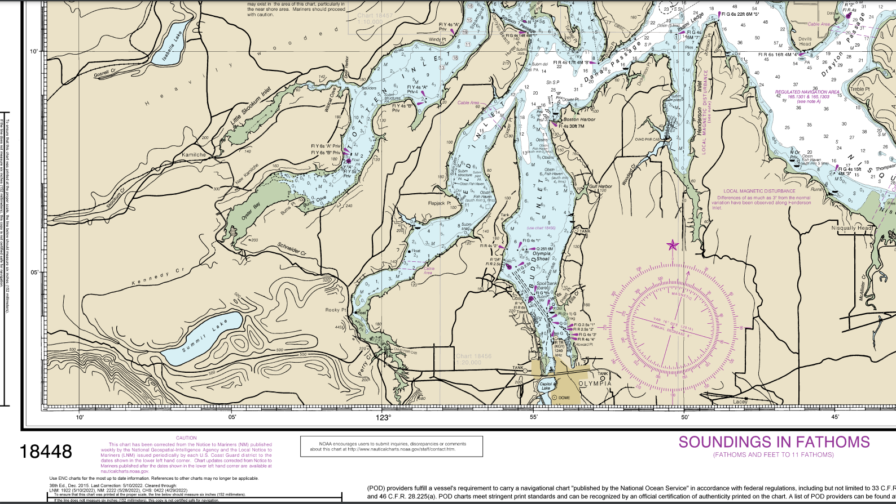

Slide 24
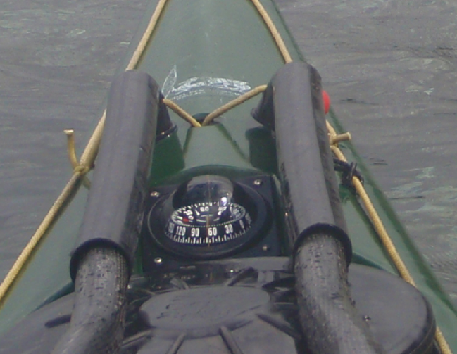
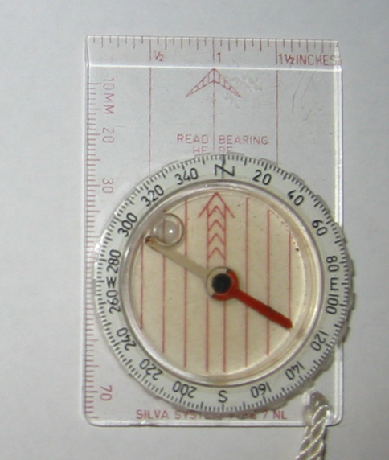
Intro to the Compass
Deck Compass
  Fixed
  Best for maintaining a course
  Watch out for deviation
    packing metal
Handheld Compass
  Good backup
  Best for fixing position
    Taking bearings.

Slide 25
Weather
Main concern is wind (and resulting waves)
Make sure to check the marine forecast
Review planned route relative to forecast wind (fetch, protection, funelling)

Slide 26
Tides & Currents
(and why you should care)
Tides height will affect launches/landings, beaches, shore access
Current speed and direction can have a huge impact on a trip – Good or Bad.

Slide 27
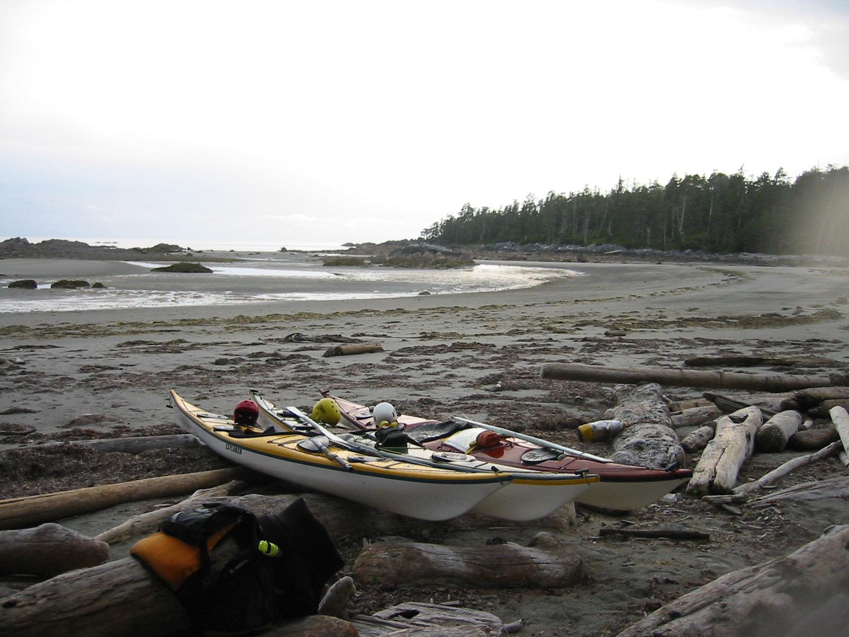
Tide Height
Where did the water go?
That’s going to be a long walk!

Slide 28
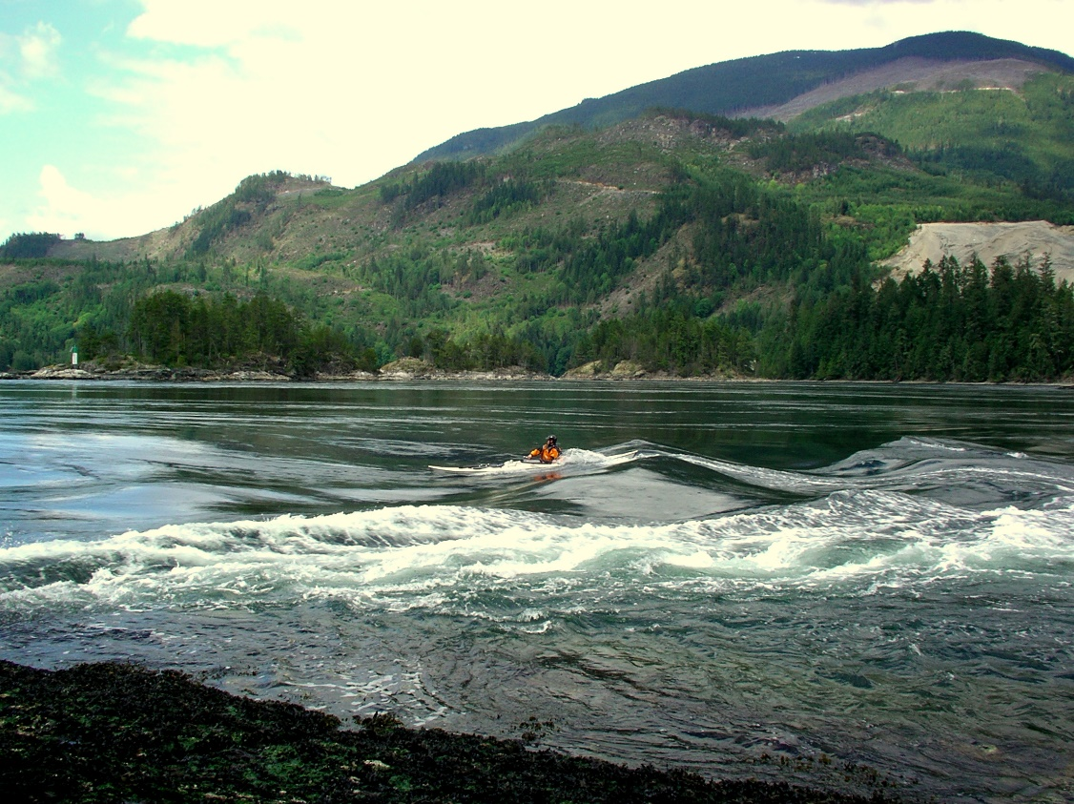
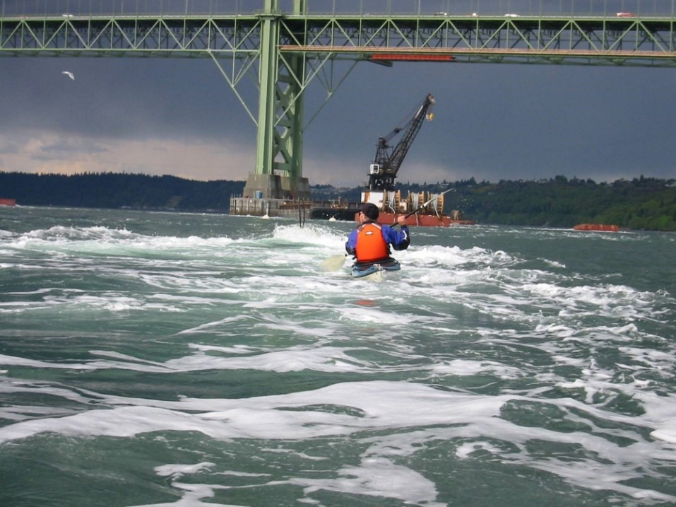
Current Speed and Direction
Sometimes, in some places, the water is moving way faster than you might like and maybe in the wrong direction.

Slide 29
First some basics
Every day we have two high tides and two low tides.
Every day it is different.
Daily range can be 16 ft. or more!
All that water has to come from somewhere and return.
That means currents, especially in narrow spots – maybe as fast as 5 knots or more!
It’s mostly the moon’s fault.

Slide 30
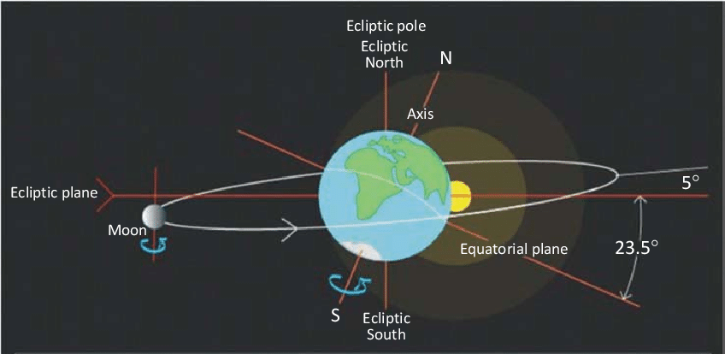
As the earth orbits the sun once a year, the moon orbits the earth every 28 days.
The earth spins on its axis once every 24 hours.
The moon and the sun pull on the water in the oceans.
Moon on our or the opposing side of earth means high tide.
Low tide means the moon is a quarter way around from that.
Everything is a little tilted.
When the moon and sun align, the pull is stronger and tides and currents are bigger.

Slide 31
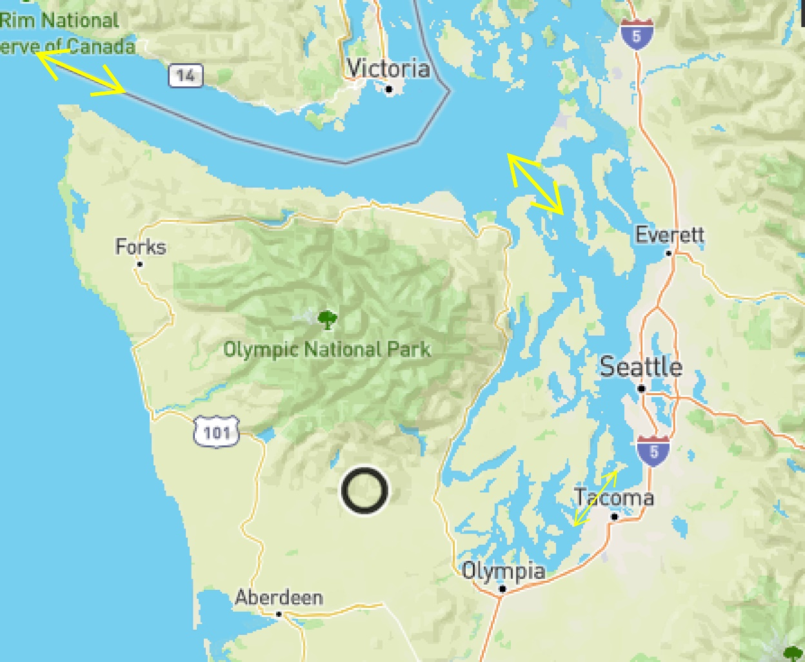
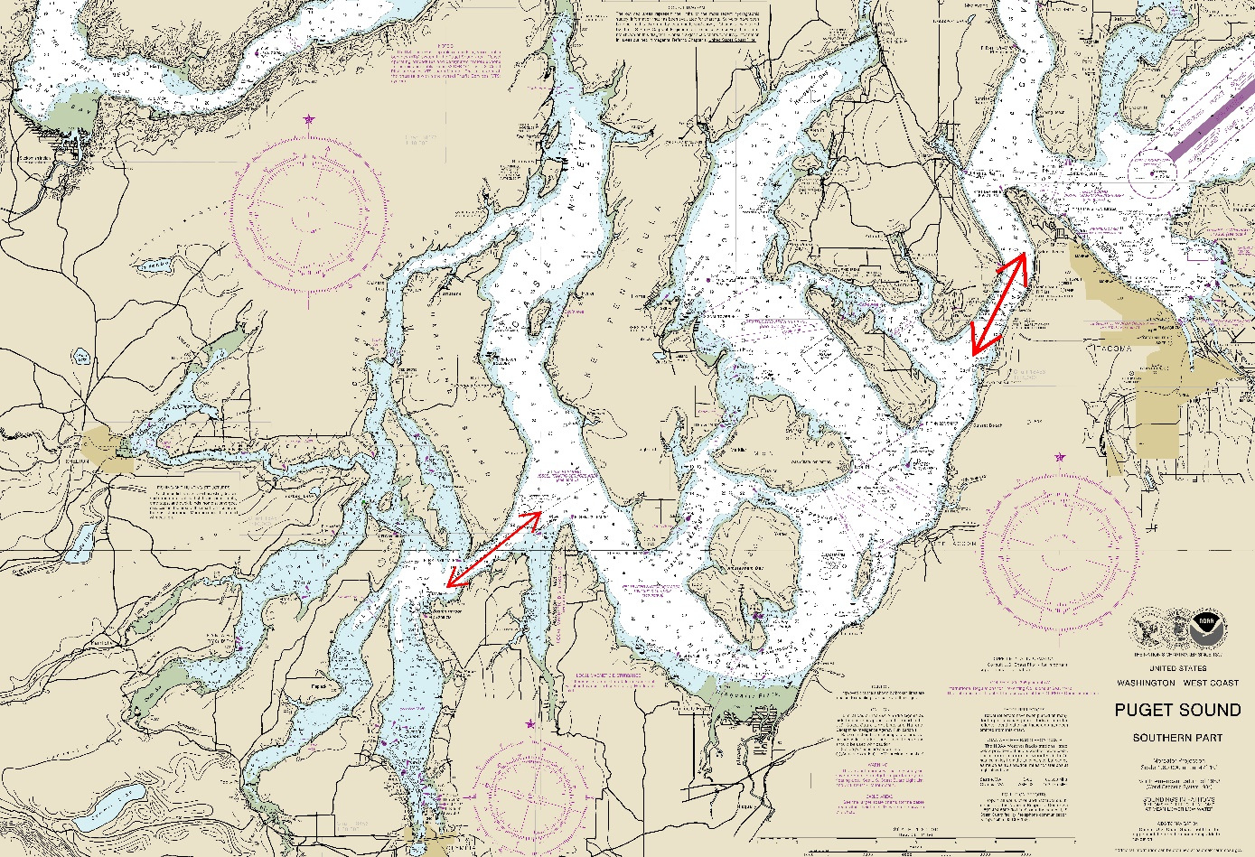
Where does all that water come from?

Slide 32
How do we know what’s going to happen?
Tide height and current speed are predicted at specific locations – “Tide and current stations”
NOAA makes the predictions based on past data and mathematical models: https://tidesandcurrents.noaa.gov/
We like the online, graphical tool: https://deepzoom.com/
Many other apps and tools are available including for mobile devices: Tides & Currents, FLYTOMAP INC (Android)

Slide 33
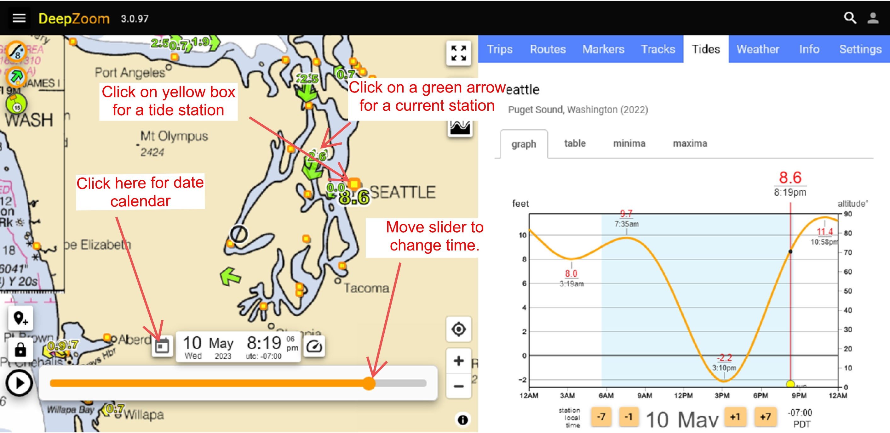
DeepZoom.com

Slide 34
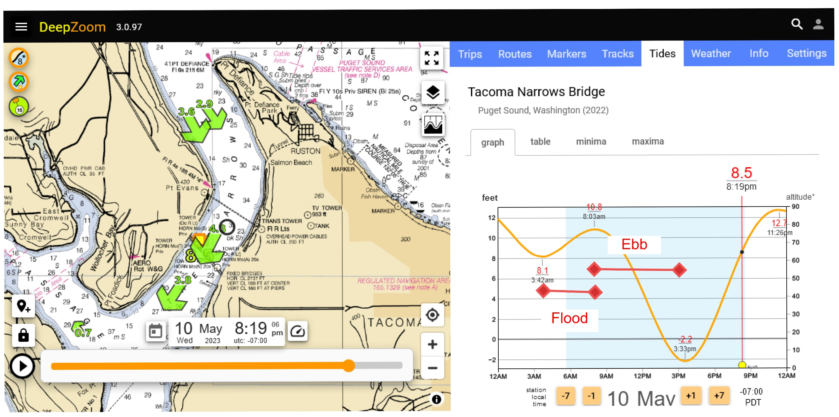
Tidal Terminology

Slide 35
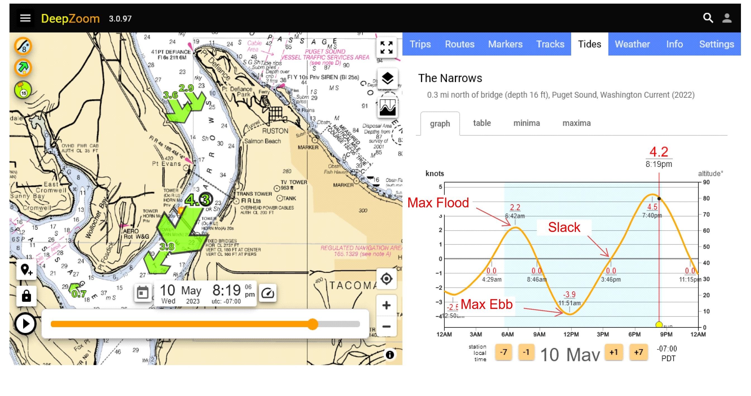
Current Terminology

Slide 36
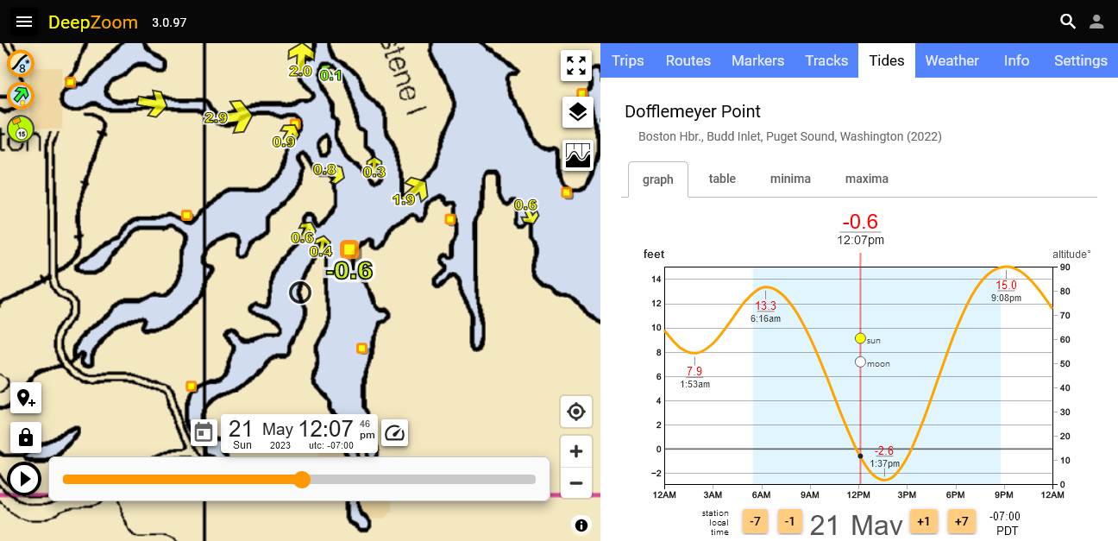
Pick a time and place - tides

Slide 37
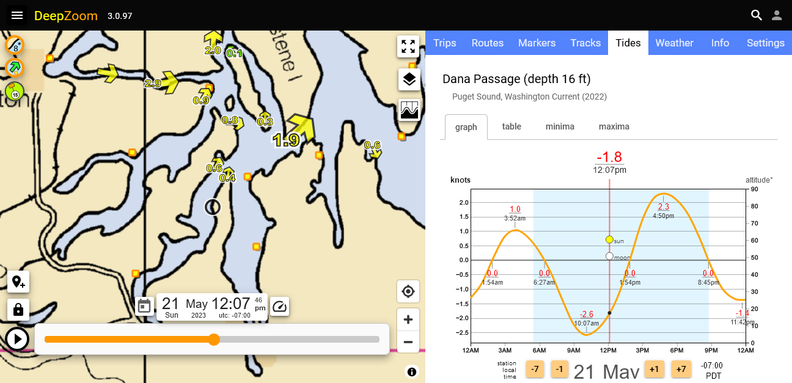
Pick a time and place – current

Slide 38
What this all means to you.
Check tide heights to be sure you have enough beach to land on, but not mud flats that would be a problem.
Know the currents where you will be traveling. Remember that if you paddle at 2 kts., you won’t go anywhere against a 2 kt. current. (But with a 2 kt. current, your ground speed is 4 kts.)
Higher current speeds can cause “dynamic” water – rips, eddylines, boils and even whirlpools.
A 15 knot wind against a current will double wave heights!
Currents in South Sound can be a challenge and an opportunity.

Slide 39
Some final tips
The current prediction at a current station is just for that point. It will be slower away from the channel center and may even be moving the other direction in a back eddy near one of the shores.
Current usually flows towards a point on both sides in both current cycles.
Current circulates around number of islands in South Sound.
Picking Passage currents run the opposite direction you would expect – ebb north.
Current assisted trips can be fun – “Shelton Shuttle”

Slide 40
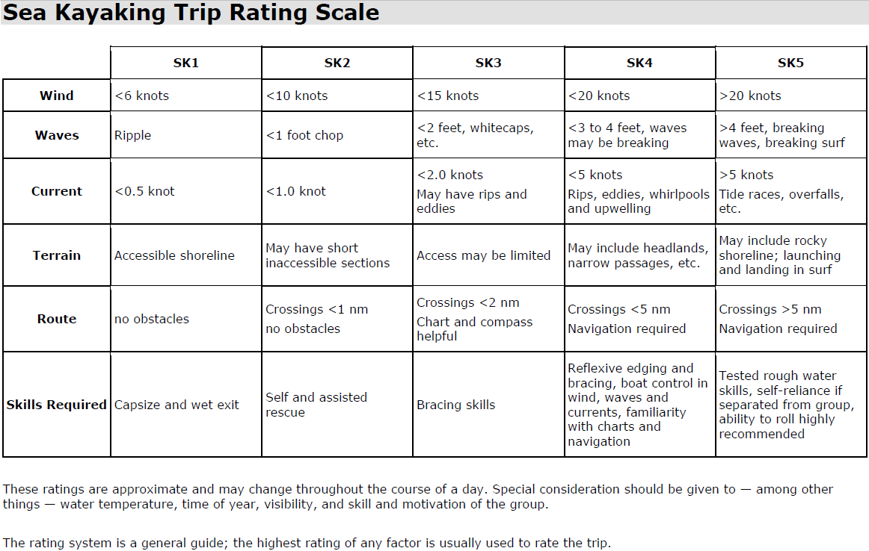

Slide 41
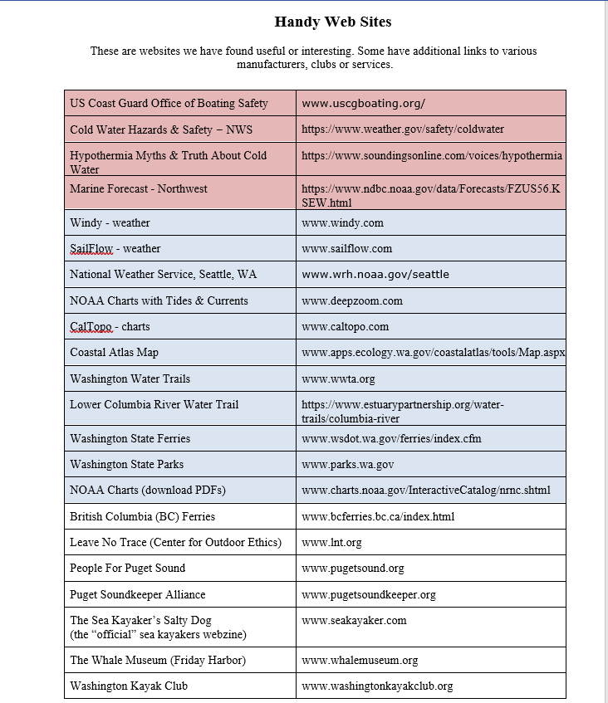

Slide 42
Experience Paddles
You will need to successfully complete at least one paddle with the Mountaineers of at least 7 nautical miles
A list of these paddles will be available by next Wednesday and will be updated regularly
Please schedule your experience paddle so you can graduate and be able to paddle with the club.

Slide 43
Paddle Float Rescue
Maintain contact with boat and paddle
Turn kayak up-right
Place float on paddle, then inflate
Place paddle on kayak
Get horizontal in water, stay low, and slide onto back deck
Keep pressure on paddle float for balance
Stay low, enter the cockpit, and always face the paddle float
Leave the paddle float in place until all water evacuated, spray skirt is attached and boat is stable

Slide 44
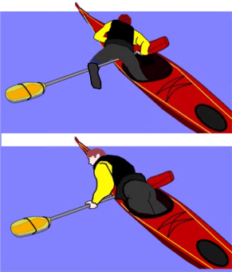
Paddle Float Rescue

Slide 45
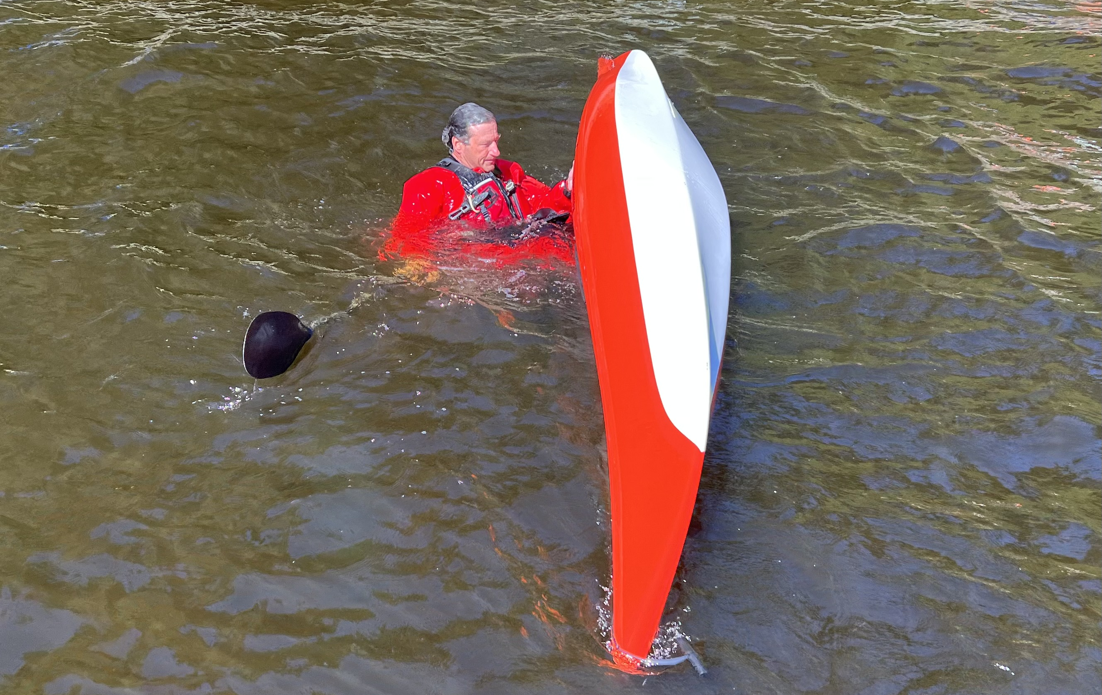
Flip boat

Slide 46
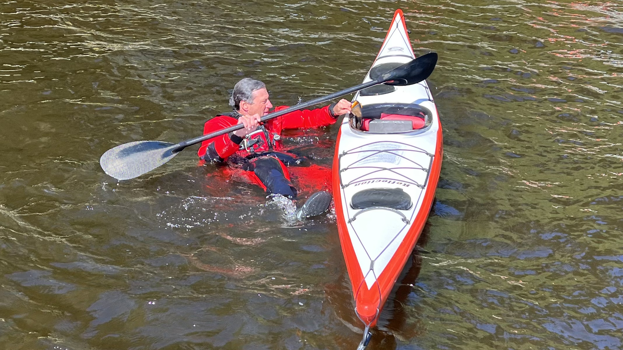
Retrieve paddle float

Slide 47
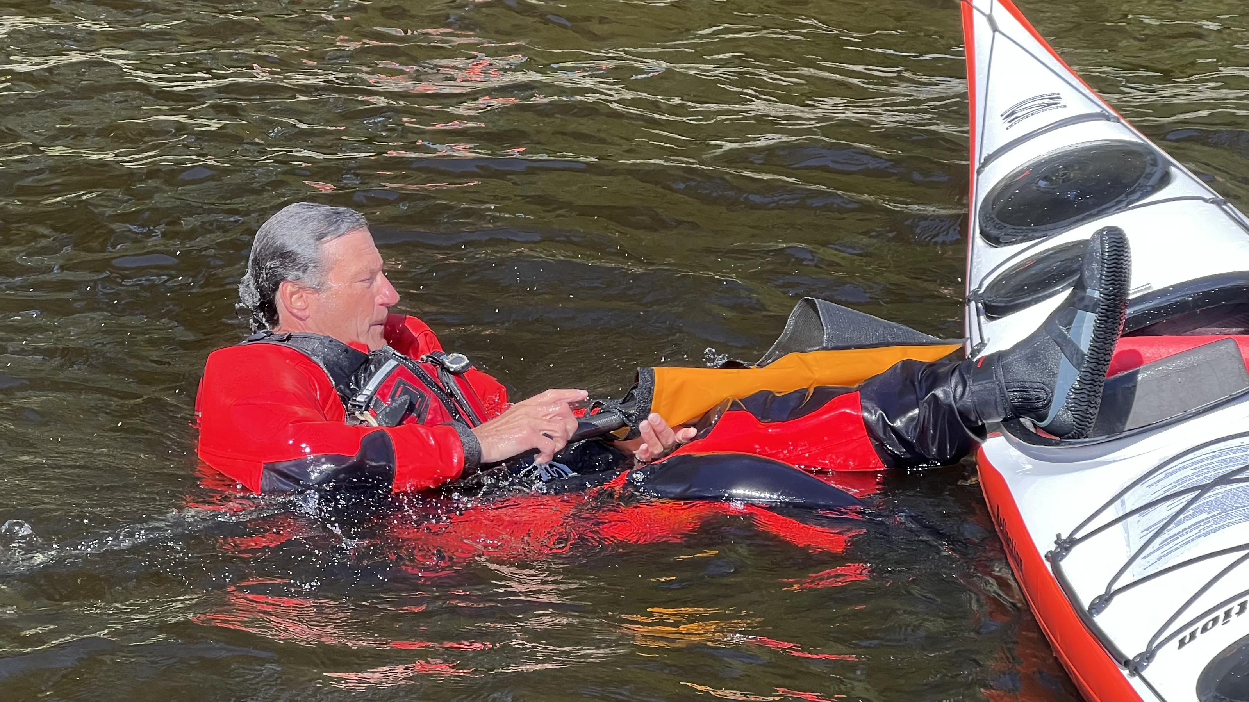
Install float onto paddle

Slide 48

Inflate float

Slide 49

Slide paddle under deck rigging behind cockpit

Slide 50

Position yourself behind paddle

Slide 51

Place outside foot over paddle

Slide 52

Reach over boat and pull your chest onto back deck

Slide 53

Move other foot onto paddle and swing foot into cockpit

Slide 54

Place hand (weight) on paddle and swing other leg into cockpit

Slide 55

Rotate into cockpit, maintaining hand and eyes on paddle

Slide 56

Switch hands on paddle and maintain weight on paddle float while getting into seat

Slide 57

Maintain weight on paddle until situated

Slide 58

Keep paddle float deployed while pumping out

Slide 59
Assisted Rescue
Immediately get hold of capsized boat
Ask if swimmer is ok while getting control of capsized boat
Have swimmer help to roll boat upright and then move to hold onto your boat
Position empty boat alongside with bow in opposite direction as yours

Slide 60

Empty water from capsized boat

Slide 61


Slide 62


Slide 63


Slide 64


Slide 65

Position empty boat alongside with bow in opposite direction as yours

Slide 66


Slide 67


Slide 68


Slide 69


Slide 70


Slide 71
Complete Rescue
Maintain positive control of boat while swimmer gets spray skirt attached.
Make sure rescued person is ok and ready to resume paddling before releasing control

Slide 72
Saturday afternoon agenda
Meet at 1:00pm to stage boats and gear
1:30pm Enter pool and swim test
Boat fitting
Boat entry & exit
Wet exit practice
Paddle float self rescue
Assisted rescue practice
Wrap up

Slide 73
What to bring
Bathing suit, rash guard shirt, wetsuit
Water shoes
Towel
Dry clothes to change back into after session

Slide 74

Discover Pass

